Slide 1
Lab 07-2: Timer

Slide 2
What is Timer ?
In general, Timer is a module that counts the number of clocks inside itself.
The term "Timer" generally has two names, namely "Timer" and "Counter"
Period of clock is unknown: Counter
Period of clock is known: Timer
The Timer of 8-bit MCU is incremental, which means it starts counting from 0. The module can set the count to notify the CPU after a certain number of clock cycles.

Slide 3
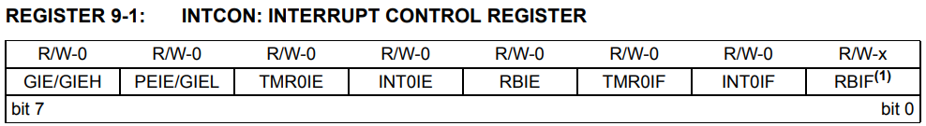
Interrupt & Timer
Notification: It is Interrupt Flag. When it counts to the setting value, the module will set the interrupt flag as 1 and send Interrupt Request to CPU.
If GIE is clear, it relies on process to check whether the event has been occurred or not.
If GIE is set, it branches to ISR automatically.
For example: the interrupt flag of Timer0 can be controlled at INTCON register.

Slide 4
PIC18F4520 Timer Module
Timer0:
Timer0 can be set as 8-bit or 16-bit mode.
The source of clock can be set as internal or external source.
Timer0 has an 8-bit prescalar.
When it comes to overflow, from FFh to 00h in 8-bit mode (or FFFFh to 0000h in 16-bit mode), it interrupts.

Slide 5
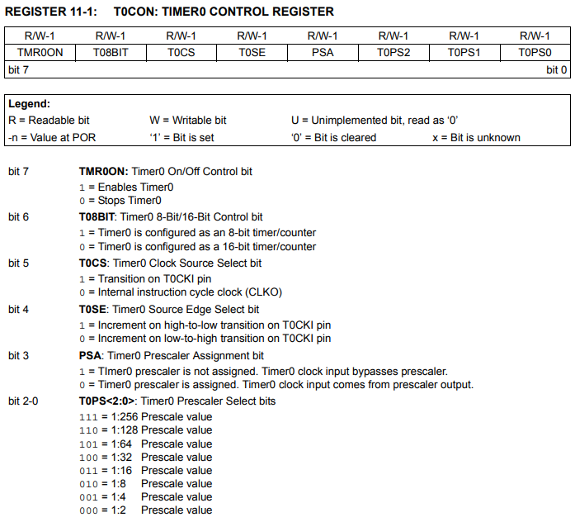
PIC18F4520 Timer0

Slide 6
Prescalar
The counting range of 16-bit Timer is 0~65535. If the requirement of counting range exceed, it can be accomplished by prescalar.
Prescalar can be used to widen the counting range.
For example:
If the prescalar is set as ÷8 (1:8), then only one clock can access to TMRx for every 8 clocks, which means when TMRx counts to 1000, 8000 clocks has been generated.

Slide 7
PIC18F4520 Timer1 & Timer3
Timer1 & Timer3:
16-bit mode counter or timer. (using TMR1H:TMR1L)
Concatenated by two readable and writable 8-bit counter
The source of clock can be set as internal or external source.
There are four options for prescalar: ÷1, ÷2, ÷4, ÷8
When it comes to overflow, from FFFFh to 0000h, it interrupts.

Slide 8
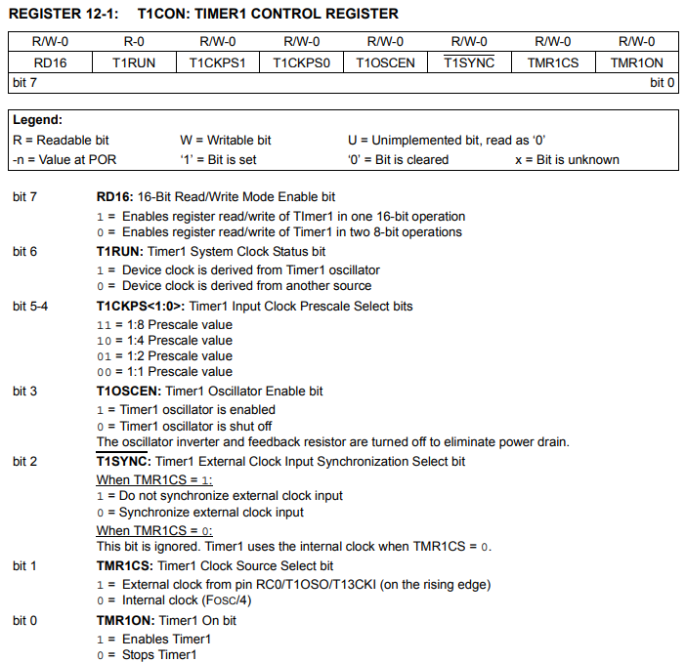
Timer1 Control Register: T1CON
Timer1 Clock Source:
Internal Clock (FOSC / 4)
Default frequency: 1MHz / 4
T1CKPS<1:0>:
Timer Input Clock Prescale Select bit
TMR1CS:
Timer1 Clock Source Select bit
TMR1ON:
Timer1 On bit

Slide 9
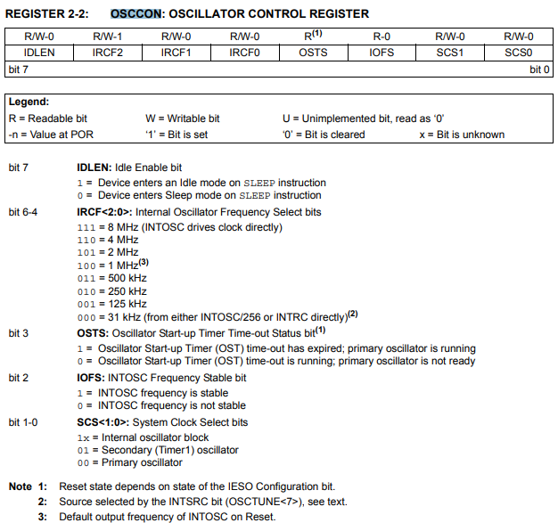
PIC18F4520 Internal Oscillator
Default Internal Oscillator Frequency: 1 MHz

Slide 10
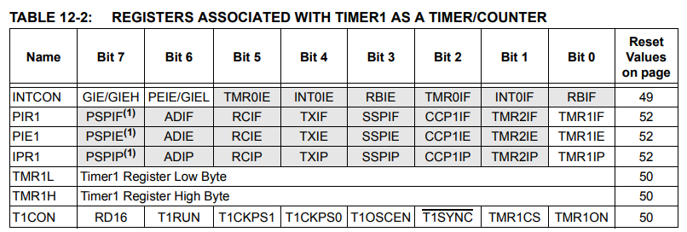
Registers Associated with Timer1
TMR1L, TMR1H: registers for Timer1. When it comes to overflow, it interrupts.
PTR1: (TMR1IF) TMR1 Overflow Interrupt Flag bit
PIE1: (TMR1IE) TMR1 Overflow Interrupt Enable bit
PTR1: (TMR1IP) TMR1 Overflow Interrupt Priority bit

Slide 11
PIC18F4520 Timer2
Timer2:
An 8-bit mode timer or counter having both prescalar and postscalar.
Timer2 automatically increment by 1 and compare with the presetting value. If the value is the same, Timer2 sends the signal to postscalar or interrupts. After sending signal, Timer2 clears the register and restarts.

Slide 12
How to get 0.5 second using Timer2
Assume that postscalar and prescalar of Timer 2 are both 1:16 and FOSC = 250kHz
instruction clock frequency = FOSC / 4 = 250kHz / 4 = 62.5 kHz => #instr clocks / second = 62.5k
# increment / second = (#instr clocks / second) / 16 / 16 = (62.5k) / 16 / 16 = 244
# increment in 0.5 second = (# increment / second) / 2 = 122
fixed
variable
0
0.5 sec
PR2 = 122
244
255
1 sec

Slide 13
How to get 0.5 second using Timer1
Assume that prescalar Timer1 is 1:2 and FOSC = 1MHz
instruction clock frequency = FOSC / 4 = 1MHz / 4 = 250 kHz => #instr clocks / second = 250k
# increment / second = (#instr clocks / second) / 2 = (250k) / 2 = 125000
# increment in 0.5 second = (# increment / second) / 2 = 62500
TMR1 = 65535 - 62500 = 3035 (0xBDB in hexadecimal )
variable
fixed
0
TMR1= 3035
62500
65535
0.5 sec

Slide 14
Summary
 | Timer0 | Timer1 | Timer2 | Timer3
Size | 8 or 16 bits | 16 bits | 8 bits | 16 bits
Prescalar options | 8 options (1:256) | 4 options (1:8) | 3 options (1:16) | 4 options (1:8)
Postscalar options | None | None | 16 options (1:16) | None
When to Interrupt | Overflow | Overflow | Equal to presetting value | Overflow

Slide 15
Reference
PIC18F4520 Datasheet: https://ww1.microchip.com/downloads/en/DeviceDoc/39631E.pdf

